Slide 1
SONARLINT
SONARQUBE

Slide 2
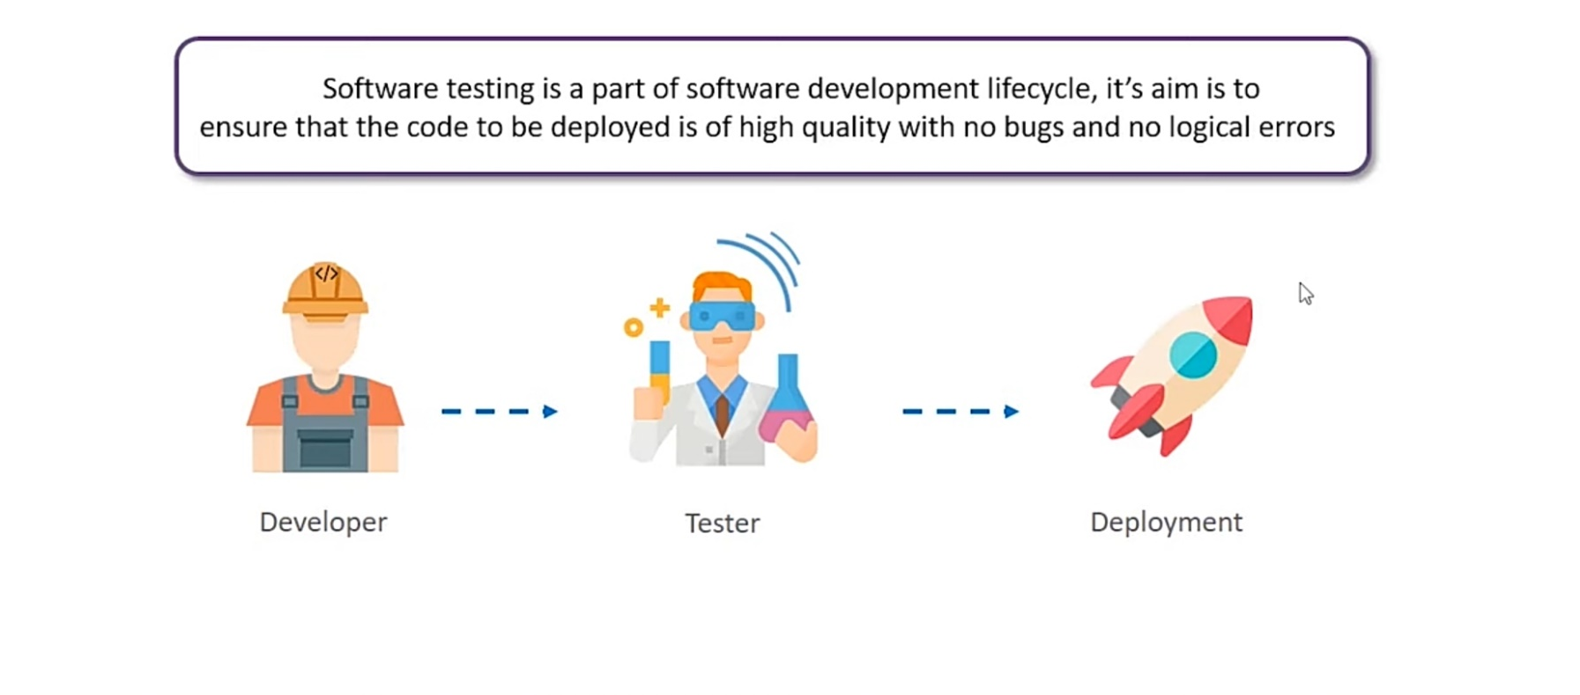
What is Software Testing :

Slide 3
Types Of Testing :
Static Code Analysis
Dynamic Code Analysis

Slide 4
Reasons To Use Static Code Analysis :
Finds errors earlier in development
Detects overcomplexity in code (refractoring /simplification)
Find Security Erros
Enforces Best Coding Practices
Automated & Integrated in Jenkins
Can create project specific rules.

Slide 5
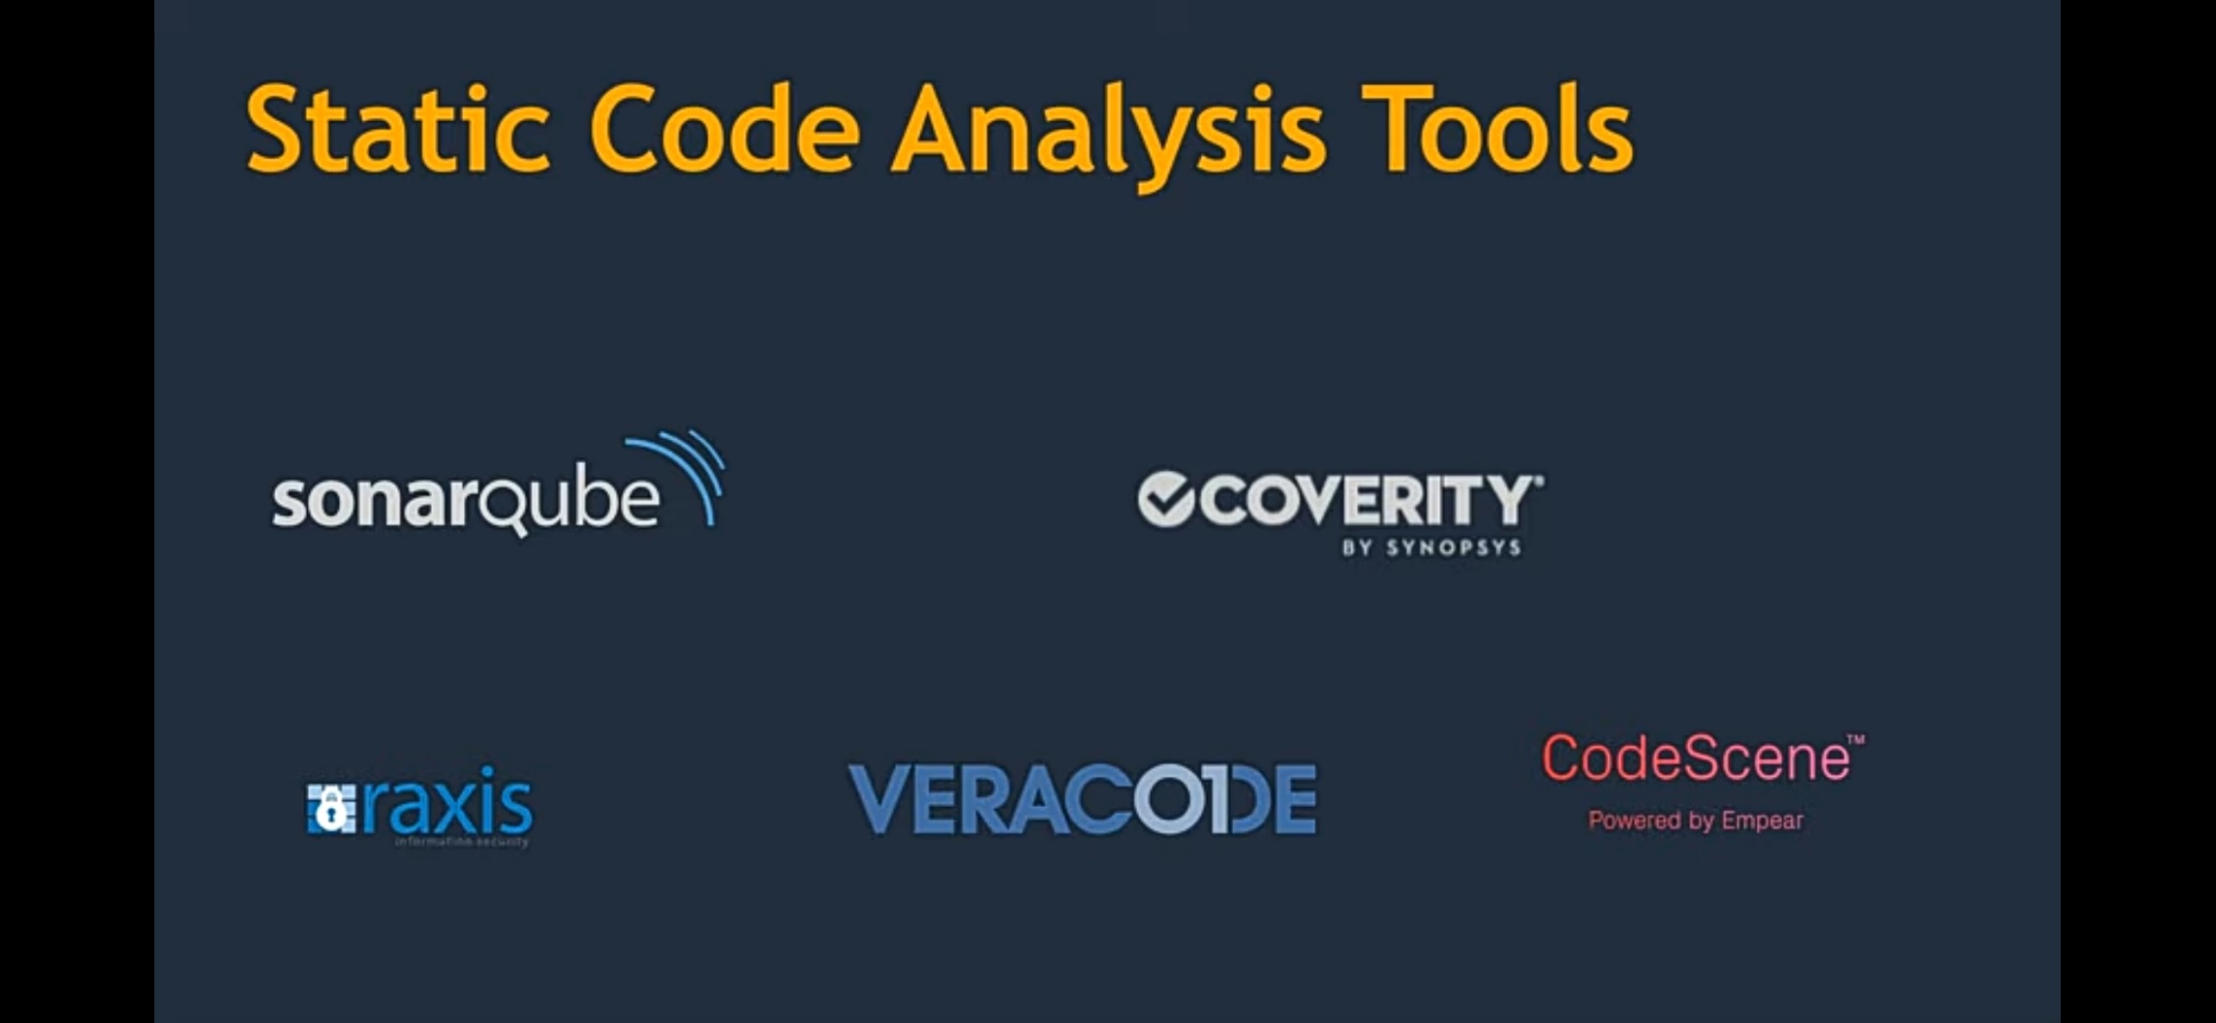

Slide 6
SonarLint :
SonarLint is a free IDE extension that finds bugs and
vulnerabilities while you code
When SonarLint reports an issue, it will always tell you if it's a bug (reliability), a vulnerability (security) or a code smell (maintainability). This allows you to rapidly understand the risks involved, and provides a true learning opportunity with the rule description

Slide 7
Installing & Working With SonarLint :
Eclipse
Help
Eclipse Marketplace
Search for SonarLint and install
We can simplify the finding errors by going -> show view->other->SonarLint

Slide 8
What is SonarQube :
SonarQube (formerly Sonar) is an open source platform for continuous inspection of code quality.
It provides a server component with a bug dashboard which allows you to view and analyze reported problems in your source code.
A IDE version of the SonarQube checks is called SonarLint and can be installed in most popluar IDE, like Eclipse, VsCode or IntelliJ.

Slide 9
Why SonarQube :
It’s act as “Quality Management Tool”
Code Analysis
Test Reports
Code Coverage

Slide 10
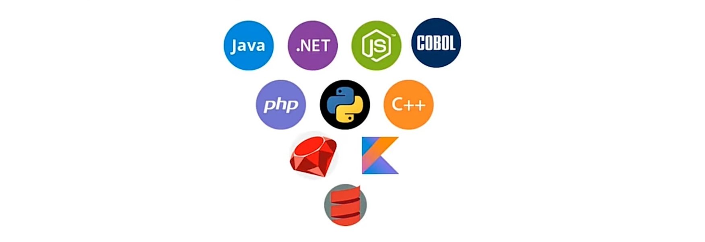
Features Of SonarQube :
It Can work with 29 different languages.

Slide 11
Features of SonarQube :
Detect Bugs
Code Smells
Security Vulnerability
Activate Rules Needed
Automated Code analysis
Get Access through webhooks & API
Integrate Github
Analyze branches and Decarate pull requests
Enforces a Quality gate

Slide 12
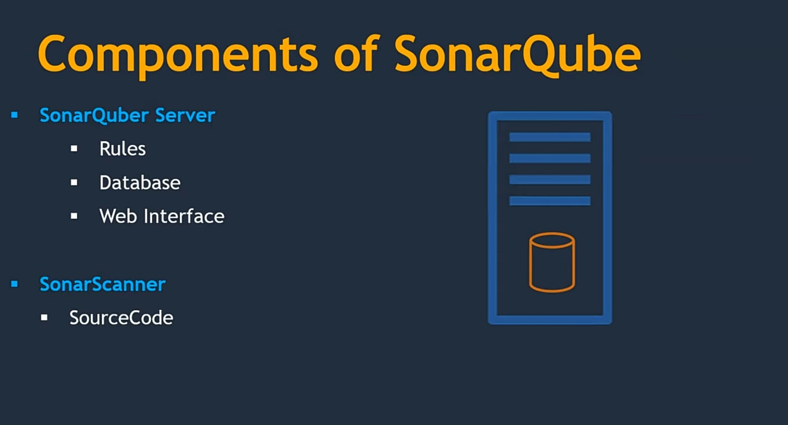
Components of SonarQube :

Slide 13

SonarQube Installation :

Slide 14
Ways to install SonarQube :
Using zip file
https://www.sonarqube.org/downloads/
Using Docker Image
https://hub.docker.com/_/sonarqube/

Slide 15
Working with SonarQube :
Download the software
\Software\sonarqube-9.6.1\bin\windows-x86- 64\StartSonar.bat
Open http://localhost:9000(default username:admin,
password :admin )
Add dependencies in pom.xml
cmd > mvn clean install
cmd > mvn sonar:sonar for version 7.3
cmd > mvn sonar:sonar –Dsonar.login=username -Dsonar.password
=password (for version latest version)

Slide 16
How to download code analysis report ?
First need to add SonarQube plugin for PDF reporting to pom.xml
Download the plugin from https://www.sonarplugins.com/pdfreport and add the
downloaded plugin at sonarqube-9.6.1.59531\extensions\plugins and restart the sonar server
We can see the report at 3 stages mentioned below
At project level
“ Project\target\sonar” folder
At SonarQube
“sonarqube-9.6.1.59531\web\WEB-INF\pdf-files
At SonarDube Dashboard
“GUI level”(localhost:9000-> click on project-> more-> reporting -> Report

Slide 17
Thank You

